Slide 1

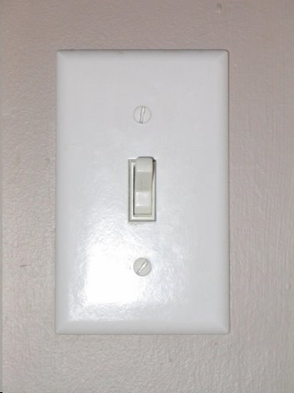
VGP332 – Artificial Intelligence
Instructor: Peter Chan

Slide 2
Agenda
Assignment 2 Redux
Finite State Machines
State Design Pattern
Messaging
Assignment 3 Overview

Slide 3
Agenda
Assignment 2 Redux
Finite State Machines
State Design Pattern
Messaging
Assignment 3 Overview

Slide 4
Assignment 1 Review
Implicit vs. explicit graphs

Slide 5

Assignment 2 Redux
Questions?

Slide 6
Agenda
Assignment 2 Redux
Finite State Machines
State Design Pattern
Messaging
Assignment 3 Overview

Slide 7

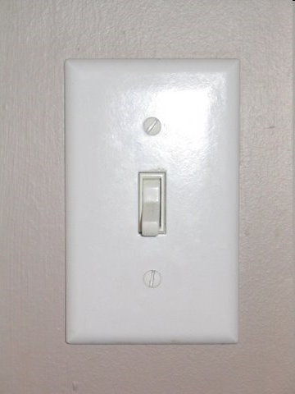
States

Slide 8
States
A state is a unique configuration of information
  Lightbulb on
  Lightbulb off
In games:
  Doom?
  Warcraft?
  Others?

Slide 9
Finite State Machines
Also called finite state automata
Many applications outside computers:
  Biology, math, logic, etc.
Within comp. sci.:
  Hardware design
  Software engineering
  Algorithm behaviour
  Artificial intelligence
  …

Slide 10
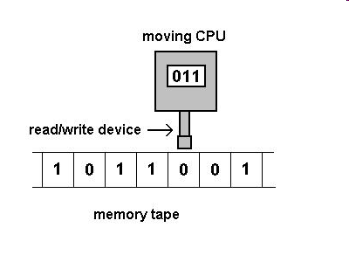
Turing Machine
Finite state machine
Operates on an infinitely long tape
Has a tape head that can:
  Move left
  Move right
  Read a symbol
  Write a symbol

Slide 11
Turing Machine
Can simulate any computer algorithm
FSMs are a good model for AI behaviours

Slide 12
Finite State Machines
Composed of:
  A finite number of states
  Transitions between those states
  Actions
Turn lightbulb off
Lightbulb Off
Lightbulb On
State
Transition
Turn lightbulb on
Action

Slide 13
Play Pacman
How many states do the ghosts have?
http://www.thepcmanwebsite.com/media/pacman_flash/

Slide 14
FSM for Ghosts in Pacman
Pacman eats ghost
Power pill wears off
Chase
Avoid
Return
Home
Pacman eats power pill
Made it home

Slide 15
switch-case Implementation
enum StateType { Chase, Avoid, ReturnHome };
void Ghost::UpdateState( StateType CurrentState )
{
switch ( CurrentState )
{
case Chase:
ChasePacman();
if ( PowerPillEaten() )
ChangeState( Avoid );
break;
case Avoid:
AvoidPacman();
if ( GhostEaten() )
ChangeState( ReturnHome );
if ( PowerPillTime() < 0 )
ChangeState( Chase );
break;
case ReturnHome:
ReturnToCenter();
if ( GhostPosition() == HomePosition )
ChangeState( Chase );
break;
}
}

Slide 16
switch-case Implementation
Pros?
Cons?

Slide 17
switch-case Implementation
Pro: Quick to code up
Pro: Handles simple cases sufficiently
Con: Not extensible
Con: Gets messy very fast

Slide 18
switch-case Implementation
Pro: Quick to code up
Pro: Handles simple cases sufficiently
Con: Not extensible
Con: Gets messy very fast
Don’t use in any but the simplest of games … and maybe not even then

Slide 19
FSM for Guard Patrol
Enemy lost
Group stronger than Enemy
Alert
Attack
Patrol
Grab
PowerUp
Call for
Help
Weaker than
Enemy
Enemy spotted
Allies
nearby
Weaker than
Enemy
PowerUp
nearby
Run Away
Enemy killed

Slide 20
State Transition Table
Current State | Condition | State Transition
Patrol | Enemy spotted | Alert
Alert | Enemy lost | Patrol
Alert | Stronger than Enemy | Attack
Alert | Weaker than Enemy | Run Away
Attack | Enemy killed | Patrol
Attack | Weaker than Enemy | Run Away
Run Away | Allies nearby | Call for Help
Run Away | PowerUp nearby | Grab PowerUp
Call for Help | - | Alert
Grab PowerUp | - | Alert

Slide 21
State Transition Table
Can be queried by agent at regular intervals
State transitions made based on table
Conditions can encompass agent, other agents, environment, etc.
Each state can be its own object external to the agent

Slide 22
State Transition Table
Pros?
Cons?

Slide 23
State Transition Table
Pros: Extensible, flexible architecture
Pros: States can be external to the agent
Cons: State transition table is internal to the agent

Slide 24
State Transition Table
Pros: Extensible, flexible architecture
Pros: States can be external to the agent
Cons: State transition table is internal to the agent
Solution: embed transitions within states

Slide 25
Agenda
Assignment 2 Redux
Finite State Machines
State Design Pattern
Messaging
Assignment 3 Overview

Slide 26
Embedded Rules
All State objects derived from a pure virtual State base class:
Derived State objects can be triggered by calling the Execute pure virtual method
class State
{
public:
virtual void Execute( Agent *agent ) = 0;
};

Slide 27
Embedded Rules
An Agent needs:
  a pointer to its current state
  a way to change its state
Note: I’m omitting the usual attributes and methods an Agent class would have (e.g., health, position, etc.)
class Agent
{
private:
State *m_pCurrentState;
public:
void Update()
{
m_pCurrentState->Execute( this );
}
void ChangeState( const State *pNewState )
{
delete m_pCurrentState;
m_pCurrentState = pNewState;
}
};

Slide 28
Embedded Rules
Passing the Agent’s pointer to the State allows the State to monitor the Agent’s attributes and modify the Agent with specific behaviour
An Agent needs:
  a pointer to its current state
  a way to change its state
class Agent
{
private:
State *m_pCurrentState;
public:
void Update()
{
m_pCurrentState->Execute( this );
}
void ChangeState( const State *pNewState )
{
delete m_pCurrentState;
m_pCurrentState = pNewState;
}
};

Slide 29
Embedded Rules
States can be completely customizable:
class State_RunAway : public State
{
public:
void Execute( Agent *agent )
{
if ( agent->isCloseToAllies() )
{
agent->ChangeState( new State_CallForHelp );
}
else if ( agent->isCloseToPowerUp() )
{
agent->ChangeState( new State_GrabPowerUp );
}
else
{
agent->MoveAwayFromEnemy();
}
}
};

Slide 30
Embedded Rules
States can be completely customizable:
class State_Attack : public State
{
public:
void Execute( Agent *agent )
{
if ( agent->groupWeakerThanEnemy() )
{
agent->ChangeState( new State_RunAway );
}
else if ( agent->enemyKilled() )
{
agent->ChangeState( new State_Patrol );
}
else
{
agent->AttackEnemy();
}
}
};

Slide 31
FSM for Guard Patrol
Enemy lost
Group stronger than Enemy
Alert
Attack
Patrol
Grab
PowerUp
Call for
Help
Weaker than
Enemy
Enemy spotted
Allies
nearby
Weaker than
Enemy
PowerUp
nearby
Run Away
Write the derived
State class for the
Alert state
Enemy killed

Slide 32
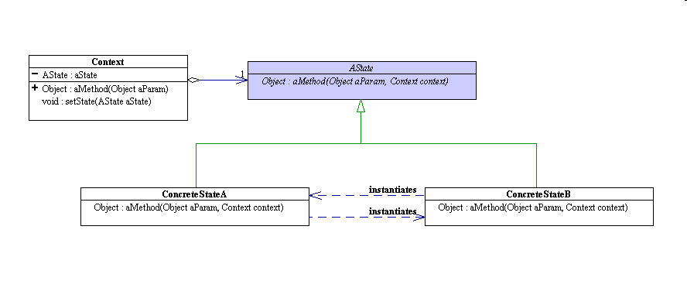
State Design Pattern
This is the state design pattern

Slide 33

WestWorld Example
Gold Mine
Wild West setting
Four locations
Miner Bob is our agent
Saloon
Bank
Miner Bob
Home
- From Programming Game AI by Example, Mat Buckland

Slide 34
WestWorld Example
Gold Mine
States = game locations
EnterMineAndDigForNugget
Saloon
Bank
QuenchThirst
VisitBankAndDepositGold
Home
GoHomeAndSleepTillRested

Slide 35
WestWorld Example
EnterMineAndDigForNugget
QuenchThirst
VisitBankAndDepositGold
GoHomeAndSleepTillRested

Slide 36
WestWorld Example
EnterMineAndDigForNugget
Thirsty
Pockets full
QuenchThirst
VisitBankAndDepositGold
GoHomeAndSleepTillRested

Slide 37
WestWorld Example
EnterMineAndDigForNugget
Thirsty
Pockets full
Not Thirsty
QuenchThirst
VisitBankAndDepositGold
GoHomeAndSleepTillRested

Slide 38
WestWorld Example
EnterMineAndDigForNugget
Thirsty
Pockets full
Not Thirsty
Not Wealthy
QuenchThirst
VisitBankAndDepositGold
Wealthy enough
GoHomeAndSleepTillRested

Slide 39
WestWorld Example
EnterMineAndDigForNugget
Thirsty
Pockets full
Not Thirsty
Not Wealthy
QuenchThirst
VisitBankAndDepositGold
Rested
Wealthy enough
GoHomeAndSleepTillRested

Slide 40
WestWorld Example
All WestWorld inhabitants have base class
class BaseGameEntity
{
private:
int m_ID; // Every entity has a unique identifying number
static int m_iNextValidID; // Next valid ID
// Verifies that value passed to the method >= next valid ID
// If so, set ID and increment to next valid ID
void SetID( int val );
public:
BaseGameEntity( int id ) { SetID( id ); }
virtual ~BaseGameEntity() {}
// All entities must implement an update function
virtual void Update() = 0;
int ID() const { return m_ID; }
};

Slide 41
WestWorld Example
Miner class, derived from BaseGameEntity
class Miner : public BaseGameEntity
{
private:
State * m_pCurrentState; // Pointer to an instance of a State
location_type m_Location; // Miner’s current location
int m_iGoldCarried; // # of nuggets in miner’s pocket
int m_iMoneyInBank; // Amount of money in bank
int m_iThirst; // Higher value = thirstier miner
int m_iFatigue; // Higher value = miner more tired
public:
Miner( int ID );
void Update();
void ChangeState( State *pNewState ); // Change to new state
/* rest of interface omitted */
};

Slide 42
WestWorld Example
Update class, called every “frame”
void Miner::Update()
{
// Miner’s always getting thirsty
m_iThirst += 1;
// Execute state logic
if ( m_pCurrentState )
{
m_pCurrentState->Execute( this );
}
}

Slide 43
State Design Pattern
Pros?
Cons?

Slide 44
State Improvements
States can be made more flexible with additional action states:
  Enter
  Exit
Examples?
Executed once, when agent enters that state
Executed once, when agent exits that state

Slide 45
State Improvements
Add those methods to the State base class:
class State
{
public:
virtual ~State() {}
// This will execute when the state is entered
virtual void Enter( Miner * ) = 0;
// This is called by the miner’s update function
virtual void Execute( Miner * ) = 0;
// This will execute when the state is exited
virtual void Exit( Miner * ) = 0;
};

Slide 46
Back to the Miner Class
Implement the ChangeState method
void Miner::ChangeState( State *pNewState )
{
// Both states need to be valid
assert ( m_pCurrentState && pNewState );
// Call the exit method of the existing state
m_pCurrentState->Exit( this );
// Change state to the new state
m_pCurrentState = pNewState;
// Call the entry method of the new state
m_pCurrentState->Enter( this );
}

Slide 47
EnterMineAndDigForNugget
Miner should change location to gold mine
Once at gold mine, dig for gold
When pockets full, change state to VisitBankAndDepositNugget
If miner gets thirsty, change state to QuenchThirst

Slide 48
EnterMineAndDigForNugget
class EnterMineAndDigForNugget : public State
{
private:
EnterMineAndDigForNugget() {}
/* copy ctor and assignment op omitted */
public:
// This is a singleton
static EnterMineAndDigForNugget *Instance();
virtual void Enter( Miner *pMiner );
virtual void Execute( Miner *pMiner );
virtual void Exit( Miner *pMiner );
};

Slide 49
Singleton Pattern
DETOUR
Used when you want only one instance of a class
Usually this object coordinates actions across the application
Less messy than global variables

Slide 50
Singleton Pattern
Examples in games:
  Render manager
  NIS manager
  Load scheduler
  Front End
  …
  …

Slide 51
Singleton Pattern
Singleton class declaration
class Singleton
{
public:
static Singleton* Instance();
protected:
Singleton();
Singleton(const Singleton&);
Singleton& operator= (const Singleton&);
private:
static Singleton* pinstance;
};
From http://www.inquiry.com/techtips/cpp_pro/10min/10min0200.asp

Slide 52
Singleton Pattern
Singleton class implementation
Singleton* Singleton::pinstance = 0; // initialize pointer
Singleton* Singleton::Instance ()
{
if (pinstance == 0) // is it the first call?
{
pinstance = new Singleton; // create sole instance
}
return pinstance; // address of sole instance
}
Singleton::Singleton()
{
//... perform necessary instance initializations
}
From http://www.inquiry.com/techtips/cpp_pro/10min/10min0200.asp

Slide 53
Singleton Pattern
All of the following return the same instance:
Singleton *p1 = Singleton::Instance();
Singleton *p2 = p1->Instance();
Singleton & ref = * Singleton::Instance();

Slide 54
EnterMineAndDigForNugget
class EnterMineAndDigForNugget : public State
{
private:
EnterMineAndDigForNugget() {}
/* copy ctor and assignment op omitted */
public:
// This is a singleton
static EnterMineAndDigForNugget *Instance();
virtual void Enter( Miner *pMiner );
virtual void Execute( Miner *pMiner );
virtual void Exit( Miner *pMiner );
};

Slide 55
EnterMineAndDigForNugget
void EnterMineAndDigForNugget::Enter( Miner *pMiner )
{
// If the miner is not already located at the gold mine,
// he must change location to the gold mine
if ( pMiner->Location() != goldmine )
{
cout << “\n” << GetNameOfEntity( pMiner->ID() ) << “: “
<< “Walkin’ to the gold mine”;
pMiner->ChangeLocation( goldmine );
}
}

Slide 56
EnterMineAndDigForNugget
void EnterMineAndDigForNugget::Execute( Miner *pMiner )
{
// Dig one nugget of gold
pMiner->AddToGoldCarried(1);
// diggin’ is hard work
pMiner->IncreaseFatigue();
cout << “\n” << GetNameOfEntity( pMiner->ID() ) << “: “
<< “Pickin’ up a nugget”;
// if enough gold mined, go and put it in the bank
if ( pMiner->PocketsFull() )
{
pMiner->ChangeState( VisitBankAndDepositGold::Instance() );
}
// if thirsty go and get a whiskey
if ( pMiner->Thirsty() )
{
pMiner->ChangeState( QuenchThirst::Instance() );
}
}

Slide 57
EnterMineAndDigForNugget
void EnterMineAndDigForNugget::Exit( Miner *pMiner )
{
cout << “\n” << GetNameOfEntity( pMiner->ID() ) << “: “
<< “Ah’m leavin’ the gold mine with mah pockets full o’ gold”;
}

Slide 58
WestWorld Code
Browse through the code to see how this all fits together
Try it out

Slide 59
State Improvements
class State
{
public:
virtual ~State() {}
// This will execute when the state is entered
virtual void Enter( Miner * ) = 0;
// This is called by the miner’s update function
virtual void Execute( Miner * ) = 0;
// This will execute when the state is exited
virtual void Exit( Miner * ) = 0;
};
What if you had other inhabitants, like a bandit and a sheriff?

Slide 60
State Improvements
Use a templated class:
template <class entity_type>
class State
{
public:
virtual ~State() {}
// This will execute when the state is entered
virtual void Enter( entity_type * ) = 0;
// This is called by the entity’s update function
virtual void Execute( entity_type * ) = 0;
// This will execute when the state is exited
virtual void Exit( entity_type * ) = 0;
};

Slide 61
EnterMineAndDigForNugget
Each state for the miner entity is now derived from an appropriately templated State
The State base class is now very reusable
class EnterMineAndDigForNugget : public State<Miner>
{
/* OMITTED */
};

Slide 62
Global States
Usually a number of states need to be accessible from every state
  Sims: going to the bathroom
  Bots: needing health
  Others?
Rather than duplicate code, use a global state
And usually, after finishing with the global state, the agent returns to previous task

Slide 63
Adding Global State to Miner
class Miner : public BaseGameEntity
{
private:
State<Miner> * m_pCurrentState;
State<Miner> * m_pPreviousState;
State<Miner> * m_pGlobalState;
/* ... */
public:
void ChangeState( State<Miner> * pNewState );
void RevertToPreviousState();
/* ... */
};

Slide 64
Miner’s Wife
VisitBathroom
1 in 10 chance
Return to previous state
DoHousework
Global state not shown
Triggers the 1 in 10 chance from any state
VisitBathroom reverts to previous state

Slide 65
One More Improvement
Create a StateMachine class template
  Delegates state machine management from agent to separate class
Look at code!

Slide 66
WestWorld with Two Agents
Try it out

Slide 67
Finite State Machines
Pros?
Cons?

Slide 68
Finite State Machines
Pro: Quick to implement
Pro: Predictable, i.e., easy to debug
Pro: Relatively flexible
Pro: Easy mapping from design to implementation
Con: Deterministic, i.e., predictable
Con: Large, complex systems can be messy
Con: States are relatively distinct

Slide 69
Agenda
Assignment 2 Redux
Finite State Machines
State Design Pattern
Messaging
Assignment 3 Overview

Slide 70
Communication in Code
How do sections of code communicate to each other?
  Control flow
  Callbacks
  Polling
  Events

Slide 71
Messaging
Have you used / seen messaging before?

Slide 72
Messaging
Also called event-handling or event-driven architecture
In AI:
  Game agents can use messages to communicate with the world
  Game agents can use messages to communicate with each other

Slide 73
WestWorld Messaging
Miner sends “Honey, I’m Home” when he returns home
Elsa receives “Honey, I’m Home”, stops what she’s doing, changes state to CookStew
In the CookStew state, Elsa sends a delayed “Stew Ready” message to herself
Elsa receives the “Stew Ready” message some ‘frames’ later
Elsa sends the “Stew Ready” message to Miner Bob
If Miner Bob is in the GoHomeAndSleepTillRested state, he changes state to EatStew
Otherwise message is dismissed

Slide 74
New WestWorld FSM Diagrams
What would the new WestWorld FSM diagrams look like?

Slide 75
Message Classes
Telegram
  Standard message class
Look at code!

Slide 76
Message Classes
EntityManager
  “Phone book” of game entities to enable message passing
Look at code!

Slide 77
Message Classes
MessageDispatcher
  Routes messages between entities correctly
Look at code!

Slide 78
Message Classes
Handling messages
  Try current state first
  If message not handled, try global state
Code modified:
  BaseGameEntity
  State
  StateMachine
Look at code!

Slide 79
WestWorld Messaging
Try it out

Slide 80
Messaging
Pros?
Cons?

Slide 81
Agenda
Assignment 2 Redux
Finite State Machines
State Design Pattern
Messaging
Assignment 3 Overview

